Slide 1
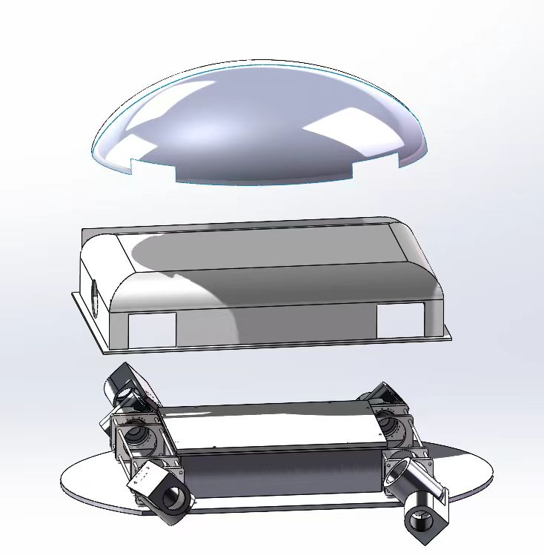
Cavity
Cavity Profile
Overall design of the cavity
The outermost layer is used to reduce water friction and bionic shape
The outer chamber is used to hold all parts of the tortoise and to provide water resistance
The inner cavity is used for secondary waterproofing and placing the chip

Slide 2
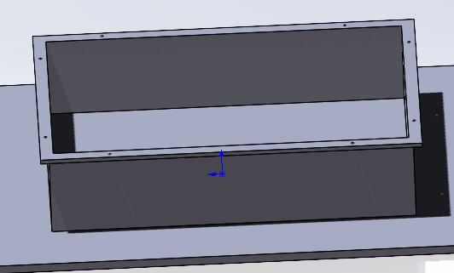
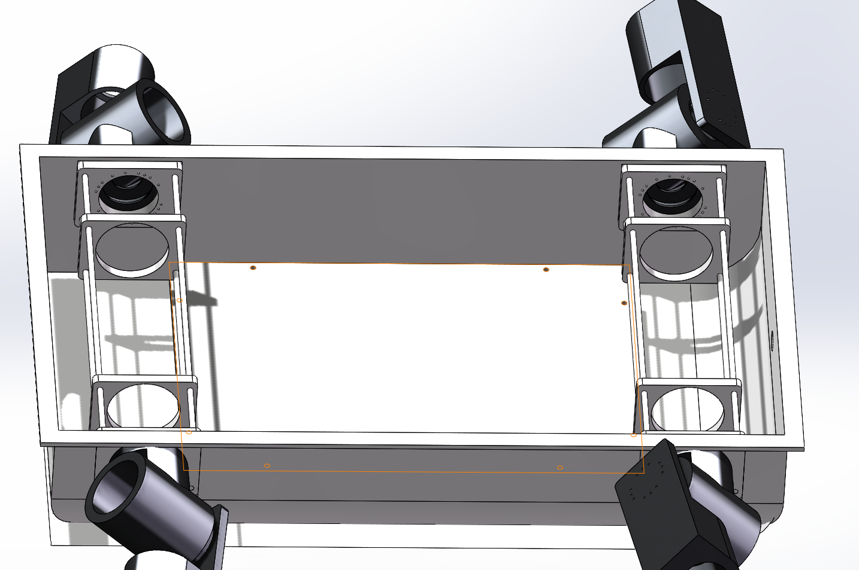
Cavity
Waterproofing method
1.Placing the chip in a designed waterproof box with rubber seals and fasteners can completely isolate the device and protect it from moisture.
2.Use a waterproof coating (similar to wax) to smear or cover the shell and connecting parts of the turtle
3.Use a waterproof film to wrap the turtle's internal components in key areas

Slide 3
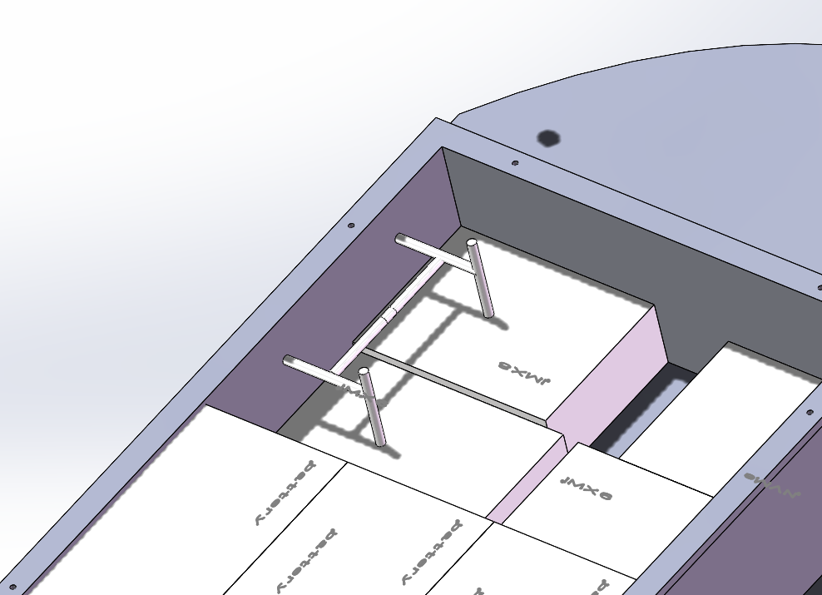
Cavity
Water-cooling system
Fixtures are used to attach the circuit
board to the bottom of the inner cavity
for heat dissipation
The fixture is used to secure the chip to the bottom plate and a flowing water cooling system is used to cool the chip

Slide 4
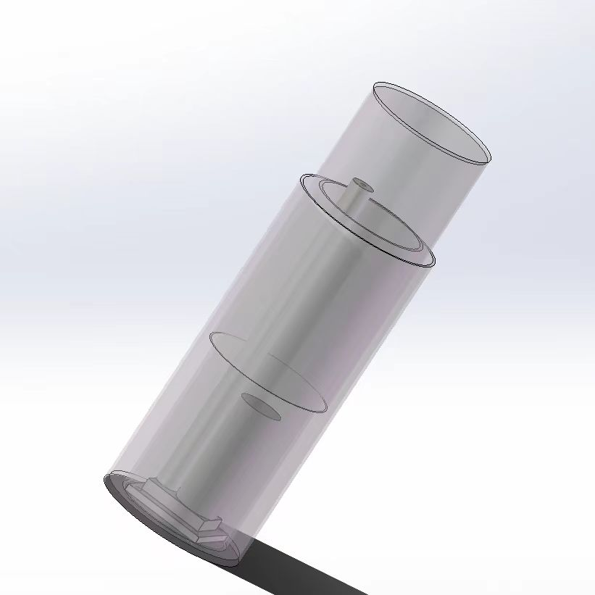
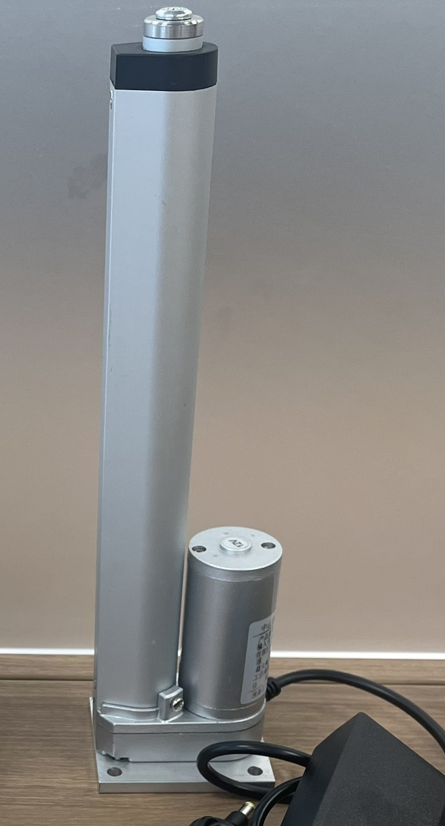
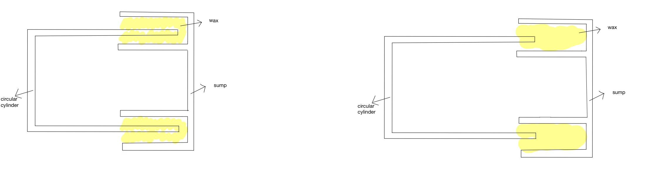
Cavity
Overall design of the cylinder
Place the jack in the cylinder for control
cylinder volume, using wax with high
friction to prevent water
from entering
Cylinder travel is as follows:

Slide 5
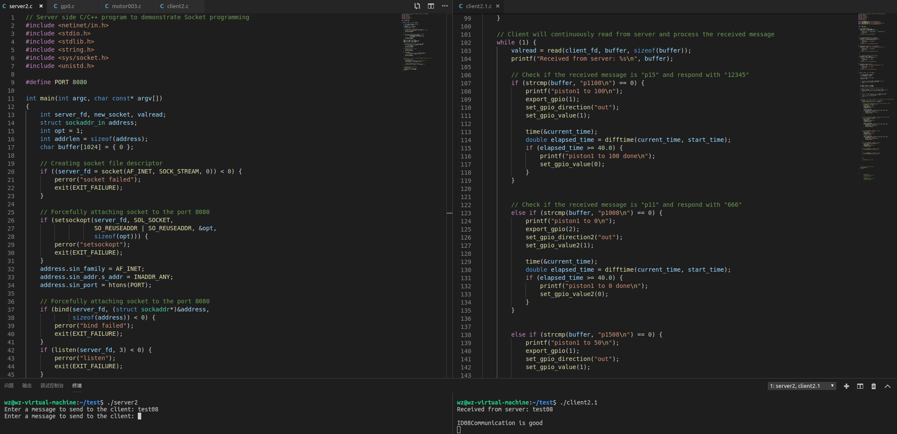
Cavity
Cylinder control code
The movement of the cylinder is controlled by socket communication

Slide 6
Cavity
The recent fortnight's work is:
1) Completion of the design for mounting all arm and neck fixings to the inner cavity
2) Fixation of chips and batteries to the inner cavity
3) Complete all control codes for the piston airbag
Follow up work for:
Work after the start of the school year
1) Test and verify to make sure functionality is intact
2) Materialize the design of the cylinder and control its movement
3) Completion of the waterproof design according to the needs of the cavity
4) Simulation of pressure analysis and friction analysis of an cavity underwater

